Slide 1
A Standards-Based Review of Wearable and loT Technologies in Parkinson's Telemedicine
Final Project Presentation
Team 6: Shujun Jiang, Liqi Kou, Jidong Wang

Slide 2
Background
Parkinson’s Disease (PD): Affects over 10 million people globally; requires continuous monitoring.
Technological Advances: Wearables and IoT enable real-time tracking of symptoms like tremor, gait abnormalities, and motor fluctuations.
Telemedicine Use: Expands monitoring to remote/home settings, improving access and continuity of care.

Slide 3
Research Questions
What standards currently exist to support secure and interoperable use of wearable/IoT devices in Parkinson’s telemedicine?
How to ensure secure, interoperable, and clinically actionable data exchange?
How are these standards categorized and applied across different technologies?
Which areas (e.g., security, clinical integration) are underrepresented in current literature?
How can these standards improve both patient safety and clinical utility of device-generated data?

Slide 4
Informatics themes and key issues
Communication and Data Exchange Standards
e.g., IEEE 11073 PHD, IEEE 11073 SDC
Focus: Connectivity and interoperability of devices
Implementation Frameworks and Guidelines
e.g., FHIR, Continua Guidelines
Focus: Practical realization of interoperability
Security and Clinical Integration Standards
e.g., IEEE/UL 2933, USCDI
Focus: Secure exchange and integration with EHRs
Collaborative Development Programs
e.g., WAMIII
Focus: Global coordination for standard adoption

Slide 5
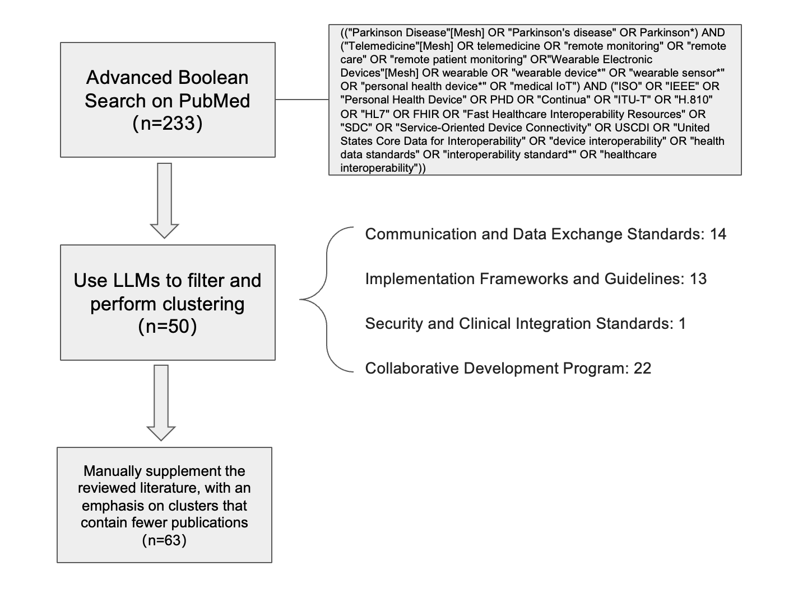
Review Method
Step 1: Landscape analysis of standards relevant to Parkinson’s telemedicine
Step 2: PubMed search using Boolean logic → 233 publications
Step 3: Filtering and clustering using LLMs → narrowed to 50 key papers
Step 4: Categorized papers into the 4 thematic groups
Note: Security and Clinical Integration standards were underrepresented → supplemented with use cases and technical documentation

Slide 6
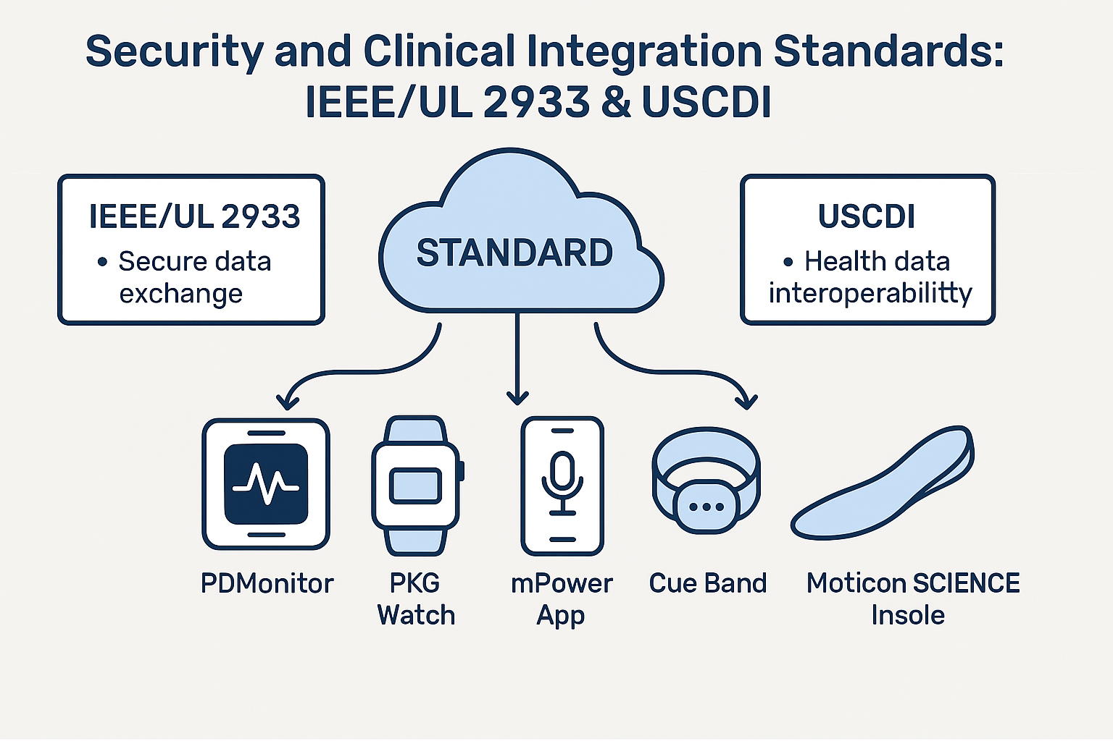
Security and Clinical Integration Standards
IEEE/UL 2933 – Secure IoT Data Exchange
Example: Moticon SCIENCE Insole
Secures transmission between device → mobile → cloud
Enables encryption, authentication, and tamper prevention
USCDI – Core Data for Interoperability
Example: Mapping wearable data (e.g., gait rhythm) to EHR functional status
Defines standard fields (vital signs, device ID, patient notes, etc.)
Supports clinical workflow integration, longitudinal tracking, and RPM reimbursement

Slide 7
Communication Standards for Medical Device Interoperability ISO/IEEE 11073 Personal Health Device(PHD) Standards in Parkinson's Disease Monitoring
Primary Focus: It provides framework for reliable data transmission and enables standardized plug-and-play connectivity between PD monitoring devices to clinical systems.
ISO/IEEE 11073 PHD standards also creates consistent representation of PD-specific metrics (tremor, gait, bradykinesia) across different platforms
Establishes specifications for critical parameters in PD monitoring:
Sampling rates: 20-100Hz depending on symptom being monitored
Data formatting using standardized representations (JSON, HL7 FHIR)
Timestamping requirements for accurate correlation with medication timing
Clinical impact: Allows neurologists to receive standardized, comparable data from home monitoring regardless of device manufacturer and which devices patient use, enabling more informed treatment adjustments.
Notes:
A patient uses a wristband from Company X and a shoe sensor from Company Y. Thanks to PHD’s JSON/HL7 FHIR formatting, both devices generate data that neurologists can compare directly, eliminating guesswork about device compatibility.

Slide 8
Communication Standards for Medical Device Interoperability IEEE 11073 Service-Oriented Device Connectivity (SDC): Enabling Dynamic PD Monitoring Networks
Primary Focus: Defining service-oriented architecture for point-of-care medical device communication, supporting dynamic data exchange across multiple PD monitoring devices within clinical ecosystems.
Unified PD Assessment Systems: In Parkinson's disease management, this standard enables the creation of comprehensive monitoring environments where devices measuring different aspects of PD can work together seamlessly. During clinical assessments, wearable sensors capturing tremor characteristics can automatically synchronize with systems measuring gait parameters and devices tracking medication adherence, providing neurologists with a complete picture of symptom manifestation and treatment response.
Motor and Non-Motor Symptom Integration: The SDC framework addresses one of the most challenging aspects of PD monitoring, which is to correlate motor symptoms with non-motor manifestations and medication timing.
Clinical Significance: For PD clinicians, this integration transforms fragmented measurements into cohesive patient profiles that reveal relationships between motor fluctuations, medication cycles, and daily activities. This comprehensive approach enables more personalized treatment adjustments and better understanding of individual disease progression patterns, ultimately supporting improved quality of life through more precise symptom management.
Notes:
For example, in a home monitoring scenario, a patient’s smartwatch that detects tremors can trigger additional measurements from other connected devices to assess contextual factors such as sleep quality or medication status, providing insight into symptom triggers and treatment effectiveness.

Slide 9
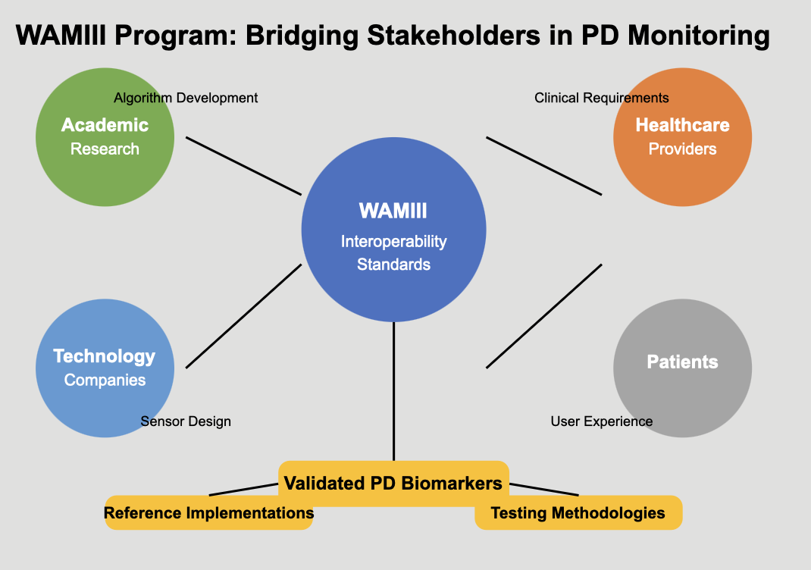
Wearables and Medical IoT Interoperability and Intelligence (WAMIII) Program WAMIII Program: Accelerating Standardization in PD Care
Primary Focus: Fostering collaboration and consensus-building for interoperability solutions in wearable and medical IoT devices for Parkinson's disease care.
Cross-Sector Integration: WAMIII unites neurologists, engineers, and technology companies to develop shared PD monitoring standards. This collaboration has produced practical solutions like standardized freezing of gait detection frameworks that work consistently across different commercial wearables, enabling reliable symptom tracking in real-world settings.
Clinical Significance: By establishing validated digital biomarkers and testing methodologies for PD symptoms, WAMIII accelerates telemedicine adoption in clinical practice. Neurologists can now incorporate remote monitoring data with confidence that measurements from different devices are comparable and clinically meaningful, supporting more timely treatment adjustments between office visits.

Slide 10
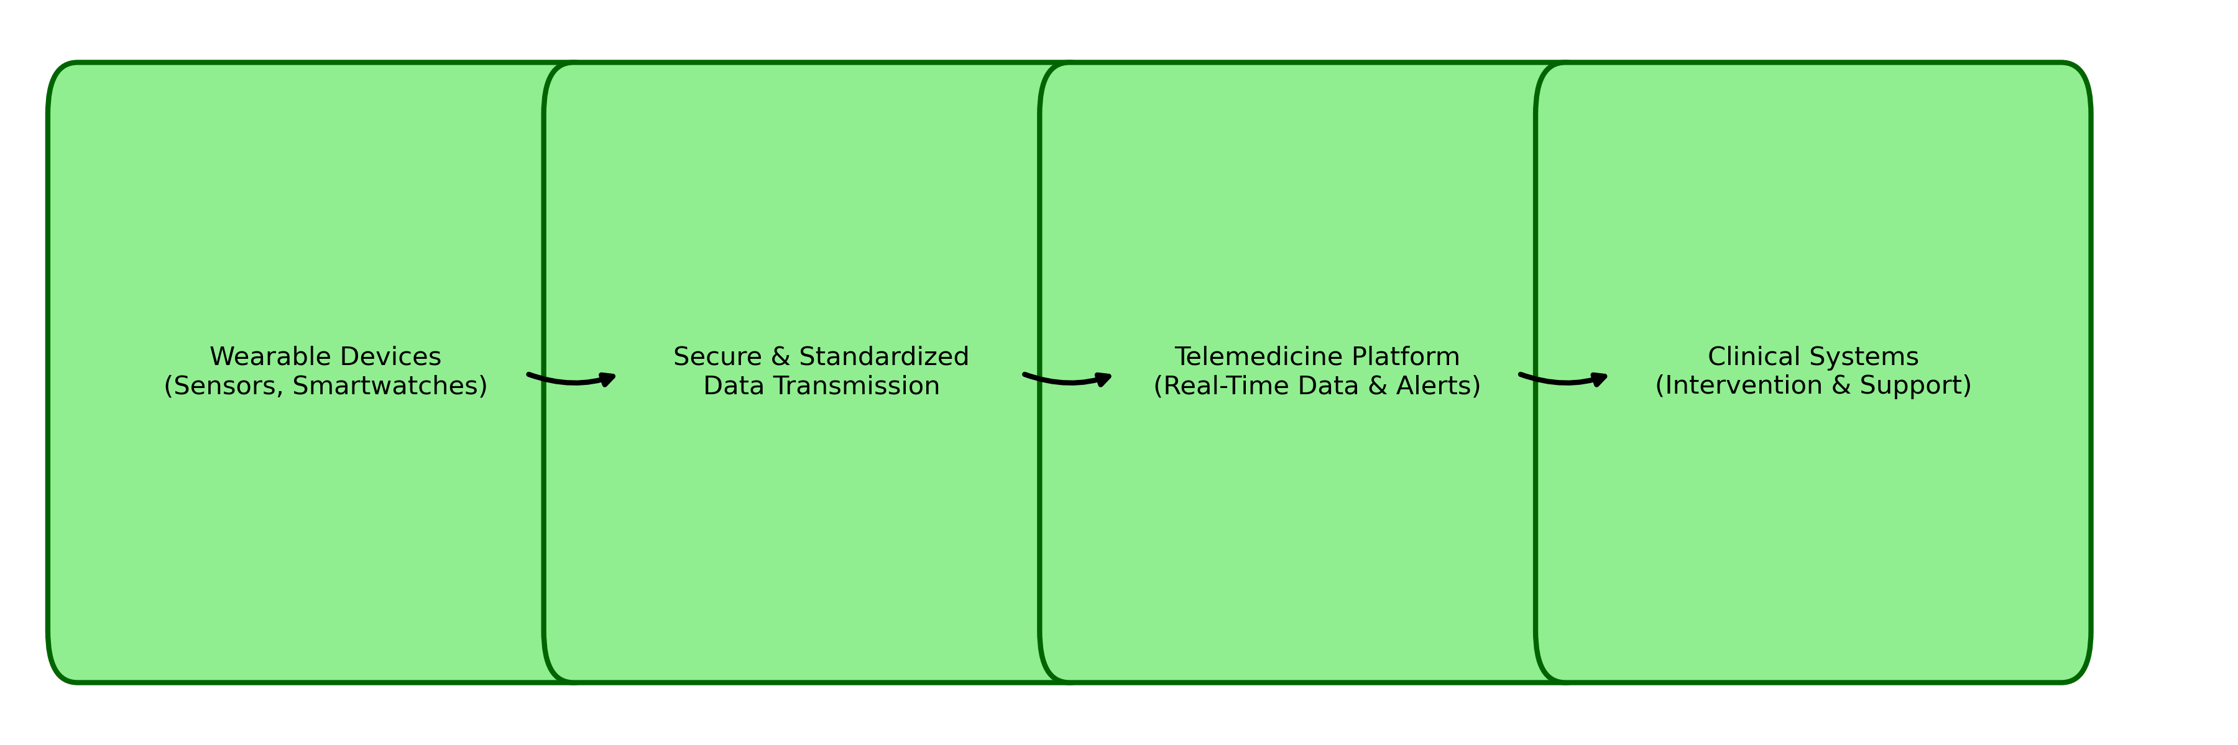
Continua Design Guidelines (ITU-T H.810)
• Secure & Standardized Data Transmission: Leverages established standards (e.g., HL7, IEEE) to ensure that data from wearable sensors is transmitted securely and with consistent integrity across telemedicine platforms.
• Interoperable Communication Protocols: Implements defined, industry-backed guidelines to enable seamless data exchange between diverse wearable and IoT devices and clinical systems, promoting a unified digital ecosystem.
• Enhanced Data Reliability & Benchmarking: Adopts standardized quality metrics that enhance the trustworthiness of remotely captured data, critical for accurate monitoring of Parkinson’s disease progression.
• Standardized Capture of Clinical Metrics: Ensures that fluctuations in motor performance and other Parkinson’s-specific indicators are measured using uniform protocols, facilitating comparability and precise trend analysis.
• Enabling Timely, Informed Interventions: Supports real-time data flow and analytics, empowering clinicians to make prompt, standards-informed treatment decisions for optimal patient outcomes.

Slide 11
HL7 FHIR Standard for Data Integration
• Pivotal Standard in Healthcare Data Exchange:
HL7 FHIR is essential for secure, standardized data sharing among wearable devices and IoT sensors, ensuring robust connectivity in Parkinson’s telemedicine systems.
• Modular Resources & APIs:
By defining modular “resources” and APIs, FHIR enables seamless communication and integration across diverse health information systems, bridging gaps between wearable sensors and clinical platforms.
• Direct EHR Integration:
Utilizing FHIR, real-time data from wearable devices is directly incorporated into electronic health records (EHRs), providing clinicians with comprehensive patient insights for effective decision-making.
• Timely Data Integration for Dynamic Care:
FHIR’s efficient data exchange protocols facilitate prompt data integration, which is critical for continuous monitoring of Parkinson’s disease progression and timely adjustment of therapeutic strategies.

Slide 12
Challenges & Clinical Implications
• Fragmented Data Streams: The lack of universal standardization across platforms leads to fragmented, inconsistent data.
• Need for Comprehensive Frameworks: This fragmentation highlights the necessity for frameworks that fully integrate the Continua Design Guidelines and HL7 FHIR.
• Personalized Treatment Support: Secure and accurate data transmission into EHRs enables a more personalized treatment approach.
• Early Symptom Detection: Continuous monitoring facilitates early detection of symptom exacerbation, allowing healthcare providers to tailor interventions in real time.
• Enhanced Healthcare Efficiency: These improvements ultimately lead to better patient outcomes and more efficient healthcare delivery.

Slide 13
Summary
• Standards-Driven Interoperability:
Our review highlights the critical role of standards—such as HL7 FHIR, ISO/IEEE 11073, IEEE 11073 SDC, and Continua Design Guidelines—in ensuring secure, reliable data exchange among wearable and IoT devices in Parkinson’s telemedicine.
• Robust Data Integration:
HL7 FHIR and related standards enable seamless, real-time integration of wearable device data directly into electronic health records (EHRs), supporting comprehensive patient monitoring and personalized treatment decisions.
• Plug-and-Play Connectivity:
Standardized frameworks facilitate consistent representation of clinical metrics (e.g., tremor, gait, bradykinesia), allowing diverse devices to operate cohesively across clinical ecosystems.
• Timely Clinical Interventions:
Reliable, standardized data transmission supports dynamic monitoring of disease progression, enabling early detection of symptom changes and prompt therapeutic adjustments.
• Collaborative Innovation:
Initiatives like the WAMIII Program drive cross-sector collaboration, accelerating the standardization process and validation of digital biomarkers critical for improved telemedicine outcomes.

Slide 14
References
Collaborative Development Program
1. Li, Y., Li, Y., Li, H., Hong, Z., & Xu, J. (2024). An 800MΩ-Input-Impedance 95.3 dB-DR Δ-ΔΣ AFE for Dry-Electrode Wearable EEG Recording. IEEE Transactions on Biomedical Circuits and Systems.
2. Amprimo, G., Masi, G., Olmo, G., & Ferraris, C. (2024). Deep learning for hand tracking in Parkinson’s disease video-based assessment: Current and future perspectives. Artificial Intelligence in Medicine, 102914.
3. MejiaCruz, Y., Caicedo, J. M., Jiang, Z., & Franco, J. M. (2024). Probabilistic Estimation of Cadence & Walking Speed From Floor Vibrations. IEEE Journal of Translational Engineering in Health and Medicine.
4. Battista, L., Casali, M., Brusa, L., Radicati, F. G., & Stocchi, F. (2023). Clinical assessment of a new wearable tool for continuous and objective recording of motor fluctuations and ON/OFF states in patients with Parkinson’s disease. Plos one, 18(10), e0287139.
5. Chen, M., Sun, Z., Xin, T., Chen, Y., & Su, F. (2023). An interpretable deep learning optimized wearable daily detection system for Parkinson’s disease. IEEE Transactions on Neural Systems and Rehabilitation Engineering, 31, 3937-3946.
6. Guo, Z., Zeng, W., Yu, T., Xu, Y., Xiao, Y., Cao, X., & Cao, Z. (2022). Vision-based finger tapping test in patients with Parkinson’s disease via spatial-temporal 3D hand pose estimation. IEEE Journal of Biomedical and Health Informatics, 26(8), 3848-3859.
7. Kostovich, C. T., Etingen, B., Wirth, M., Patrianakos, J., Kartje, R., Baharestani, M., & Weaver, F. M. (2022). Outcomes of Telehealth for Wound Care: A Scoping Review. Advances in Skin & Wound Care, 35(7), 394–403. https://doi.org/10.1097/01.ASW.0000821916.26355.fa
8. Tsanas, A., Little, M. A., & Ramig, L. O. (2021). Remote assessment of Parkinson’s disease symptom severity using the simulated cellular mobile telephone network. IEEE Access, 9, 11024-11036.
9. Ibrahim, A., Zhou, Y., Jenkins, M. E., Trejos, A. L., & Naish, M. D. (2020, July). The design of a Parkinson’s tremor predictor and estimator using a hybrid convolutional-multilayer perceptron neural network. In 2020 42nd Annual International Conference of the IEEE Engineering in Medicine & Biology Society (EMBC) (pp. 5996-6000). IEEE.
10. Viswanathan, R., Arjunan, S. P., Kempster, P., Raghav, S., & Kumar, D. (2020, July). Estimation of Parkinson’s disease severity from voice features of vowels and consonants. In 2020 42nd Annual International Conference of the IEEE Engineering in Medicine & Biology Society (EMBC) (pp. 3666-3669). IEEE.
11. O’Day, J. J., Kehnemouyi, Y. M., Petrucci, M. N., Anderson, R. W., Herron, J. A., & Bronte-Stewart, H. M. (2020, July). Demonstration of kinematic-based closed-loop deep brain stimulation for mitigating freezing of gait in people with Parkinson’s disease. In 2020 42nd Annual International Conference of the IEEE Engineering in Medicine & Biology Society (EMBC) (pp. 3612-3616). IEEE.

Slide 15
References
12. LeMoyne, R., Mastroianni, T., Whiting, D., & Tomycz, N. (2020, July). Parametric evaluation of deep brain stimulation parameter configurations for Parkinson’s disease using a conformal wearable and wireless inertial sensor system and machine learning. In 2020 42nd Annual International Conference of the IEEE Engineering in Medicine & Biology Society (EMBC) (pp. 3606-3611). IEEE.
13. Channa, A., Popescu, N., & Ciobanu, V. (2020). Wearable solutions for patients with Parkinson’s disease and neurocognitive disorder: a systematic review. Sensors, 20(9), 2713.
14. Rehman, R. Z. U., Buckley, C., Micó-Amigo, M. E., Kirk, C., Dunne-Willows, M., Mazzà, C., … & Del Din, S. (2020). Accelerometry-based digital gait characteristics for classification of Parkinson’s disease: what counts?. IEEE Open Journal of Engineering in Medicine and Biology, 1, 65-73.
15. Refai, M. I. M., van Beijnum, B. J. F., Buurke, J. H., & Veltink, P. H. (2018). Gait and dynamic balance sensing using wearable foot sensors. IEEE Transactions on Neural Systems and Rehabilitation Engineering, 27(2), 218-227.
16. Nguyen, H., Lebel, K., Bogard, S., Goubault, E., Boissy, P., & Duval, C. (2017). Using inertial sensors to automatically detect and segment activities of daily living in people with Parkinson’s disease. IEEE Transactions on Neural Systems and Rehabilitation Engineering, 26(1), 197-204.
17. Rovini, E., Maremmani, C., & Cavallo, F. (2017). How Wearable Sensors Can Support Parkinson’s Disease Diagnosis and Treatment: A Systematic Review. Frontiers in Neuroscience, 11, 555. https://doi.org/10.3389/fnins.2017.00555
18. Pasluosta, C. F., Gassner, H., Winkler, J., Klucken, J., & Eskofier, B. M. (2015). An emerging era in the management of Parkinson’s disease: wearable technologies and the internet of things. IEEE Journal of Biomedical and Health Informatics, 19(6), 1873-1881.
19. Cancela, J., Pastorino, M., Arredondo, M. T., Pansera, M., Pastor-Sanz, L., Villagra, F., … & Gonzalez, A. P. (2011, August). Gait assessment in Parkinson’s disease patients through a network of wearable accelerometers in unsupervised environments. In 2011 Annual International Conference of the IEEE Engineering in Medicine and Biology Society (pp. 2233-2236). IEEE.
20. Bachlin, M., Plotnik, M., Roggen, D., Maidan, I., Hausdorff, J. M., Giladi, N., & Troster, G. (2009). Wearable assistant for Parkinson’s disease patients with the freezing of gait symptom. IEEE Transactions on Information Technology in Biomedicine, 14(2), 436-446.
21. Patel, S., Lorincz, K., Hughes, R., Huggins, N., Growdon, J. H., Welsh, M., & Bonato, P. (2007, August). Analysis of feature space for monitoring persons with Parkinson’s disease with application to a wireless wearable sensor system. In 2007 29th Annual International Conference of the IEEE Engineering in Medicine and Biology Society (pp. 6290-6293). IEEE.
22. Bonato, P., Sherrill, D. M., Standaert, D. G., Salles, S. S., & Akay, M. (2004, September). Data mining techniques to detect motor fluctuations in Parkinson’s disease. In The 26th Annual International Conference of the IEEE Engineering in Medicine and Biology Society (Vol. 2, pp. 4766-4769). IEEE.

Slide 16
References
Communication and Data Exchange Standards
[1] Hadley, A. J., & Pulliam, C. L. (2024, July). Simulating Accelerometer Signals of Parkinson’s Gait Using Generative Adversarial Networks. In 2024 46th Annual International Conference of the IEEE Engineering in Medicine and Biology Society (EMBC) (pp. 1-4). IEEE.
[2] Boege, S., Milne-Ives, M., Ananthakrishnan, A., Carroll, C., & Meinert, E. (2024). Self-Management Systems for Patients and Clinicians in Parkinson’s Disease Care: A Scoping Review. Journal of Parkinson’s Disease, 14(7), 1387-1404.
[3] Sun, M., Jung, W., Koltermann, K., Zhou, G., Watson, A., Blackwell, G., … & Pretzer-Aboff, I. (2023, June). Parkinson’s disease action tremor detection with supervised-learning models. In Proceedings of the 8th ACM/IEEE International Conference on Connected Health: Applications, Systems and Engineering Technologies (pp. 1-10).
[4] Ricci, M., Di Lazzaro, G., Errico, V., Pisani, A., Giannini, F., & Saggio, G. (2022). The impact of wearable electronics in assessing the effectiveness of levodopa treatment in Parkinson’s disease. IEEE journal of biomedical and health informatics, 26(7), 2920-2928.
[5] Huo, W., Angeles, P., Tai, Y. F., Pavese, N., Wilson, S., Hu, M. T., & Vaidyanathan, R. (2020). A heterogeneous sensing suite for multisymptom quantification of Parkinson’s disease. IEEE Transactions on Neural Systems and Rehabilitation Engineering, 28(6), 1397-1406.
[6] Teshuva, I., Hillel, I., Gazit, E., Giladi, N., Mirelman, A., & Hausdorff, J. M. (2019). Using wearables to assess bradykinesia and rigidity in patients with Parkinson’s disease: a focused, narrative review of the literature. Journal of Neural Transmission, 126, 699-710.
[7] Pastorino, M., Cancela, J., Arredondo, M. T., Pastor-Sanz, L., Contardi, S., & Valzania, F. (2013, July). Preliminary results of ON/OFF detection using an integrated system for Parkinson’s disease monitoring. In 2013 35th Annual International Conference of the IEEE Engineering in Medicine and Biology Society (EMBC) (pp. 941-944). IEEE.
[8] Hoffman, J. D., & McNames, J. (2011, August). Objective measure of upper extremity motor impairment in Parkinson’s disease with inertial sensors. In 2011 Annual international conference of the IEEE engineering in medicine and biology society (pp. 4378-4381). IEEE.
[9] Patel, S., Chen, B. R., Mancinelli, C., Paganoni, S., Shih, L., Welsh, M., … & Bonato, P. (2011, August). Longitudinal monitoring of patients with Parkinson’s disease via wearable sensor technology in the home setting. In 2011 annual international conference of the IEEE engineering in medicine and biology society (pp. 1552-1555). IEEE.
[10] Cancela, J., Pansera, M., Arredondo, M. T., Estrada, J. J., Pastorino, M., Pastor-Sanz, L., & Villalar, J. L. (2010, August). A comprehensive motor symptom monitoring and management system: the bradykinesia case. In 2010 Annual International Conference of the IEEE Engineering in Medicine and Biology (pp. 1008-1011). IEEE.
[11] Patel, S., Chen, B. R., Buckley, T., Rednic, R., McClure, D., Tarsy, D., … & Bonato, P. (2010, August). Home monitoring of patients with Parkinson’s disease via wearable technology and a web-based application. In 2010 annual international conference of the IEEE engineering in medicine and biology (pp. 4411-4414). IEEE.
[12] Bonato P. (2009). Clinical applications of wearable technology. Annual International Conference of the IEEE Engineering in Medicine and Biology Society. IEEE Engineering in Medicine and Biology Society. Annual International Conference, 2009, 6580–6583. https://doi.org/10.1109/IEMBS.2009.5333997
[13] Giansanti, D., Maccioni, G., & Morelli, S. (2008). An experience of health technology assessment in new models of care for subjects with Parkinson’s disease by means of a new wearable device. TELEMEDICINE and e-HEALTH, 14(5), 467-472.
[14] Tamura, T. (2006, January). Wearable accelerometer in clinical use. In 2005 IEEE Engineering in Medicine and Biology 27th Annual Conference (pp. 7165-7166). IEEE.

Slide 17
References
Implementation Frameworks and Guidelines
[15] Amprimo, G., Masi, G., Olmo, G., & Ferraris, C. (2024, July). Enhancing Model Generalizability In Parkinson’s Disease Automatic Assessment: A Semi-Supervised Approach Across Independent Experiments. In 2024 46th Annual International Conference of the IEEE Engineering in Medicine and Biology Society (EMBC) (pp. 1-4). IEEE.
[16] Dousty, M., Fleet, D. J., & Zariffa, J. (2023). Hand grasp classification in egocentric video after cervical spinal cord injury. IEEE Journal of Biomedical and Health Informatics, 28(2), 645-654.
[17] Nouriani, A., Jonason, A., Jean, J., McGovern, R., & Rajamani, R. (2023). System-identification-based activity recognition algorithms with inertial sensors. IEEE Journal of Biomedical and Health Informatics, 27(7), 3119-3128.
[18] Li, J., Zhu, H., Li, J., Wang, H., Wang, B., Luo, W., & Pan, Y. (2023). A wearable multi-segment upper limb tremor assessment system for differential diagnosis of Parkinson’s disease versus essential tremor. IEEE Transactions on Neural Systems and Rehabilitation Engineering, 31, 3397-3406.
Security and Clinical Integration Standards
[19] Mazumder, O., Gavas, R., & Sinha, A. (2019, July). Mediolateral stability index as a biomarker for Parkinson’s disease progression: A graph connectivity based approach. In 2019 41st Annual International Conference of the IEEE Engineering in Medicine and Biology Society (EMBC) (pp. 5063-5067). IEEE.

Slide 18
Thank you

